Slide 1
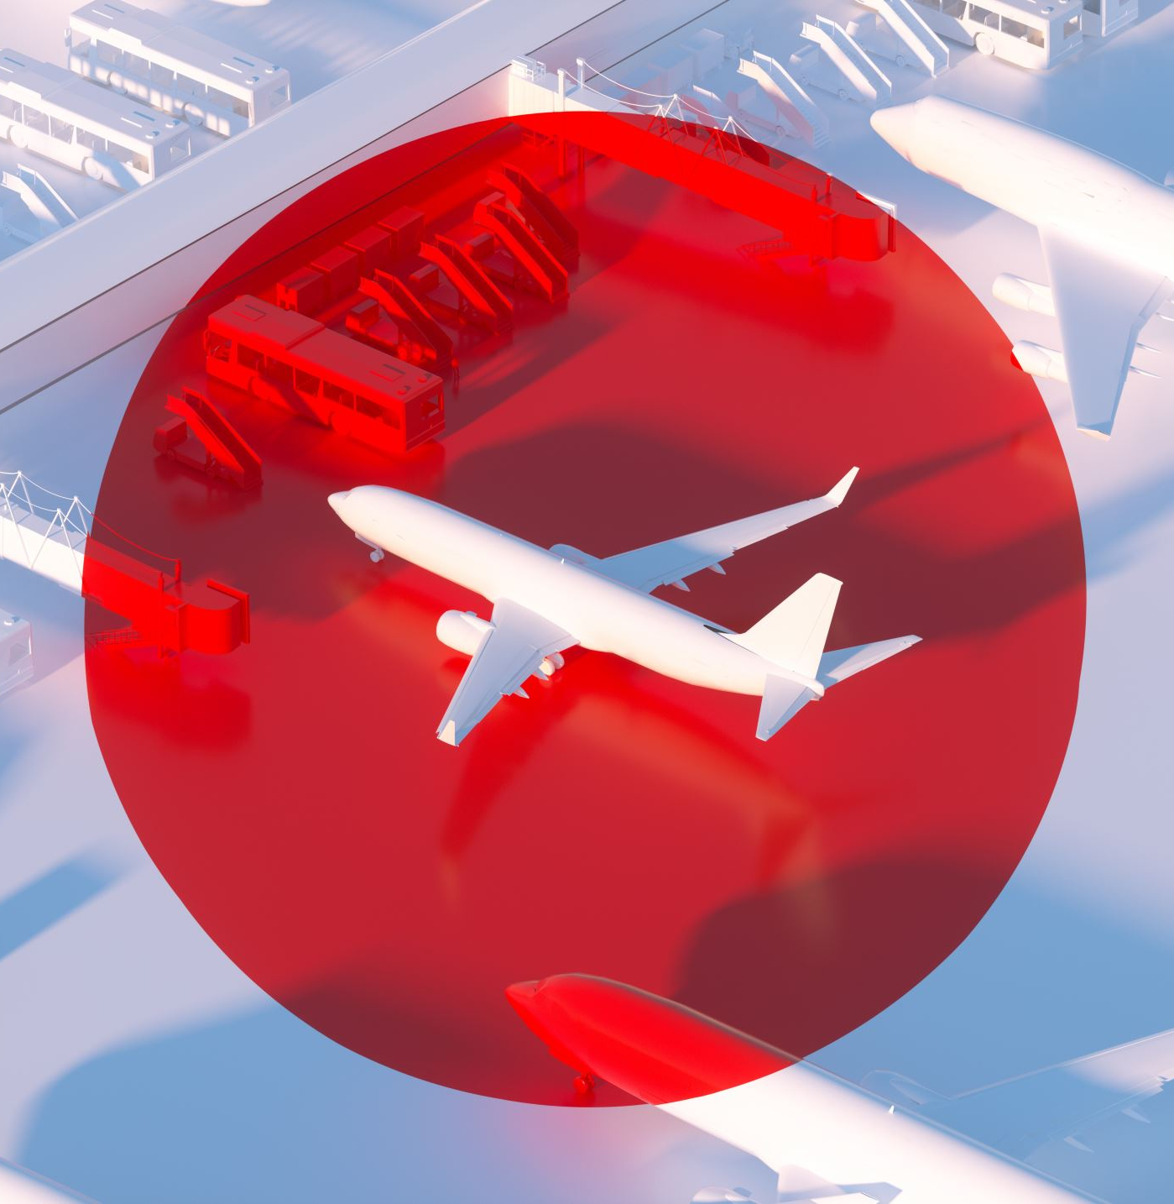
Airplane price optimization
Members:
Anish Deshpande 112010029
Soniya Bhat 112003159
Adi Shendge 112003157

Slide 2
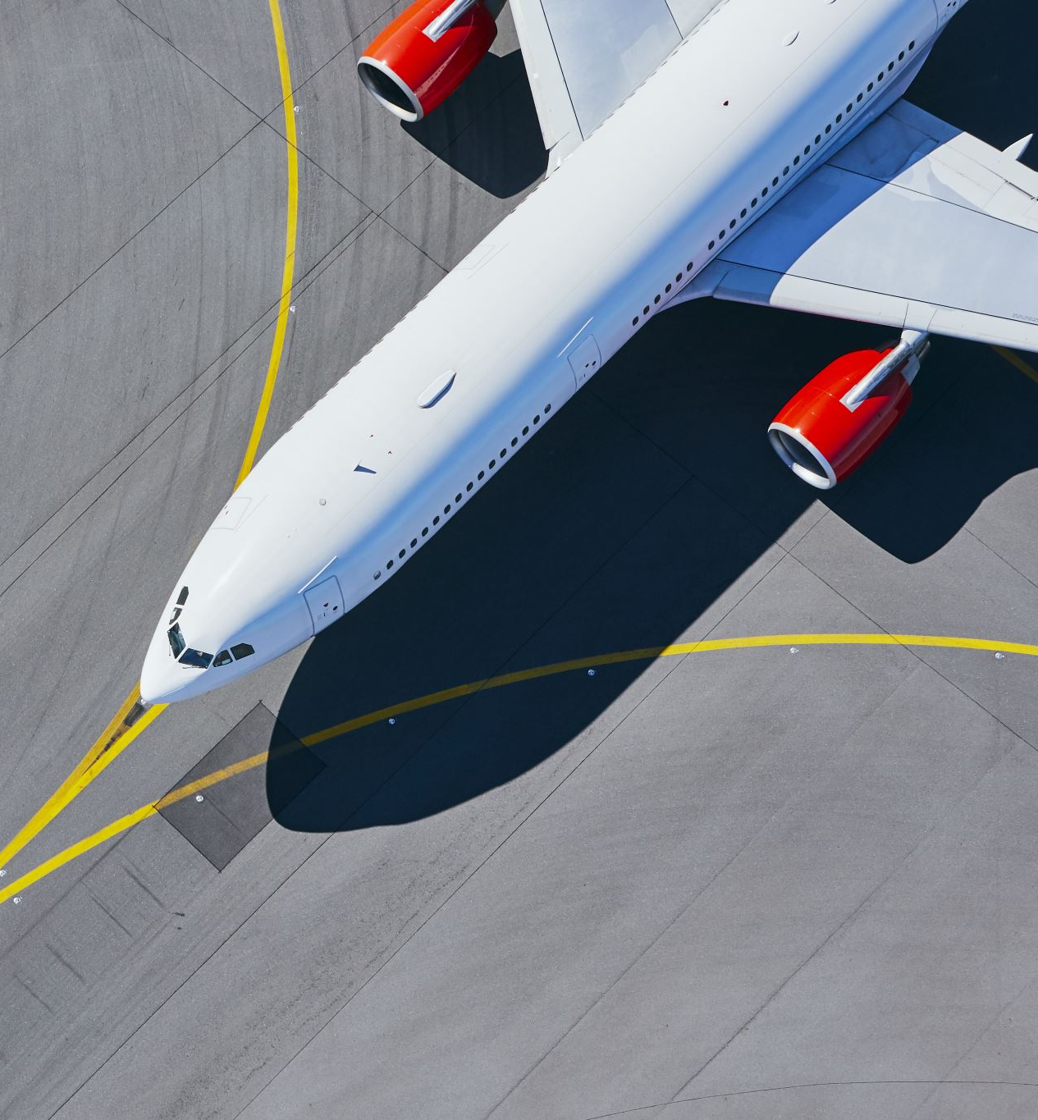
What exactly is our problem statement
Maximizing the total revenue cost of the airline company.
Due to covid-19, we have seen a huge impact on airline industries.
We need to come up with new optimization techniques which can let the companies sustain their business.
We need to set the ticket prices in such a way which benefits the airline business.`

Slide 3
Significance of the problem
The problem is important not only for the airline company but also for immigrants.
The solution to this problem benefits the airline industry as well as it affects the society greatly too.
Due to covid-19, many airline businesses are facing difficulties in sustaining.
Due to this, people who had bought tickets from such airlines, are not able to reach their homes and also, because of lesser options available now.
It is highly needed for airlines to function efficiently , so that society doesn’t suffer.

Slide 4
Available solutions
There are RM strategies available in the market along with a few dynamic pricing strategy for airline industries.
But, due to COVID-19, most of the airline companies will be undergoing complete restructuring of their system and also will be seen implementing new optimization techniques

Slide 5
Approach
We will be maximizing the total revenue collected by the airline company using a function which will be used to set the flight price for that particular day based on different parameters such as:
No. of days until the flight
No. of seats they have left to sell
A variable called demand-level which determines how many tickets you can sell at any given price
price= demand level – tickets sold
We know that, revenue= price* tickets sold
Therefore, objective function: revenue= (demand level – tickets sold )*tickets sold
Constraint: Demand level’s range-100 to 200

Slide 6
Solution
We will be using the previous mentioned equation and optimizing it.
We will be using dynamic programming as our optimization technique.
First, we will solve for optimal price when you have only one day to sell the tickets before the flight.
Then, we will continually step back to longer time-horizons one day at a time.
Hence, we will come up with a general solution which is based on these cases.

Slide 7
Solutions
We are going to optimize our revenue using this two basic functions:
1)Value function: V(tickets_left,days_left) is a function which returns the most expected revenue which can be achieved based on the number of tickets you have and the no. of days left before the flight.
2)Q-function: Similar to value function but we take our decision as an input and it gives revenue even if our decision policy is not optimum.
The output of the Q function for T+1 days before the flight will depend on how much revenue is the sum of
1)revenue from flights sold that day
2)revenue earned in the last T days from the remaining tickets.
We will first calculate daily revenue. After we have calculated Q and the value function (denoted V) near flight time, we ,then iteratively work backwards, hence, can calculate revenue from the last T days from the value function.
Once we have Q at time T+1, we calculate V on that day by looking up the revenue associated with the best decision from Q.

Slide 8
Base cases 1&2:
First base case to be considered: 1)Revenue from Selling tickets for a single day:
As we discussed in our approach to the solution, we are going to optimize the equation: revenue= (demand level – tickets sold )*tickets sold
This will give us the revenue for that particular day.
2) Selling tickets with only one day left:
In this case, we will be filling Q values with revenue= price* tickets_sold. We won’t have to worry about future values as this is the last day before the flight.

Slide 9
Input Code
All the mentioned logic is then, implemented in our python code.

Slide 10
Output
The output is now seen after the program is run.
It displays the average revenue generated by 200 flights that fly 100, 14, 2 and 1 day before the flight. It also displays the average revenue across all flights, thus then maximizing the revenue by setting proper prices for tickets.

Slide 11
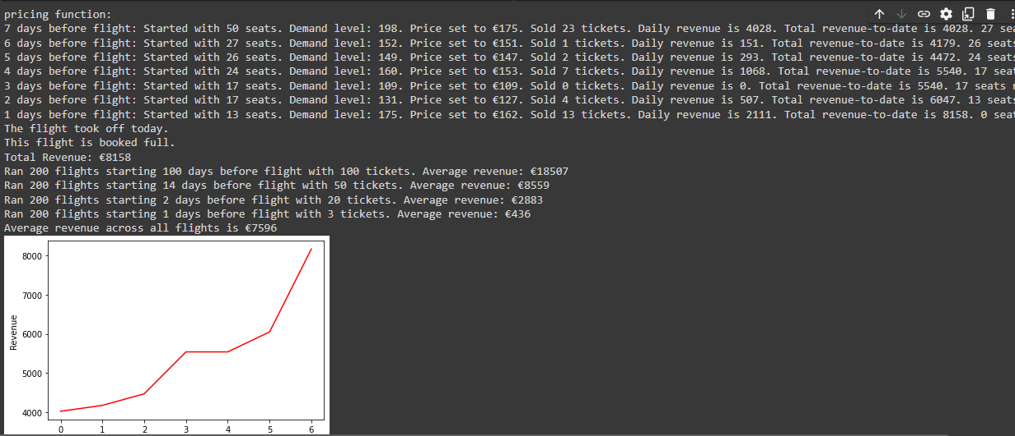
The incomplete text on the right-hand side reads “seats remaining”.

Slide 12
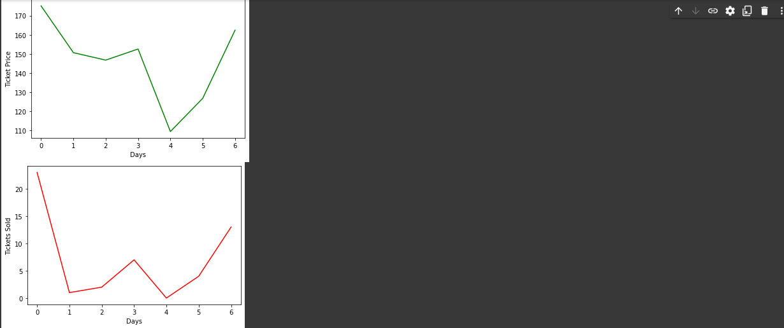
The graphs here as well as in the previous slide depict how the revenue(graph 1), ticket price(graph 2) and number of tickets sold (graph 3) changes with each day.

Slide 13
Demerits
It is possible that after some research, we might understand that the problem is already understood or solved and its solutions are being implemented or will be implemented as soon as the airline industry starts becoming active as it used to.
As we are optimizing airline prices based on small(basic) parameters, and not taking other factors into consideration, many modifications will be required to fully optimize the revenue in the future

Slide 14
Conclusion
We are able to understand how airlines set their ticket pricing and the parameters they use to optimize the revenue as much as possible.
We designed a basic algorithm for airline revenue optimization based on ticket pricing.
We can make an application based on this optimization solution as well in future.
We can analyze how the ticket pricing affects the revenue further, and based on this analysis, we can try to make more changes and consider other external parameters which we have not considered in this optimization solution .
This leaves us with more room for modification in the solution we used, in the future for better optimization.
We might be able to use this model for setting prices of other items as well and try to optimize the profit benefited from selling those items ,i.e. we can use it for business enhancement purposes.

Slide 15
Citations
https://core.ac.uk/download/pdf/9342472.pdf
https://w3.accelya.com/blog/pulling-back-the-curtain-on-dynamic-airline-pricing
https://www.sciencedirect.com/science/article/abs/pii/S0965856414001177
https://link.springer.com/article/10.1057/s41272-019-00224-3
https://resources.pros.com/airline-revenue-optimization/possible-airlines-dynamic-pricing
https://link.springer.com/article/10.1057/rpm.2010.33

